Slide 1

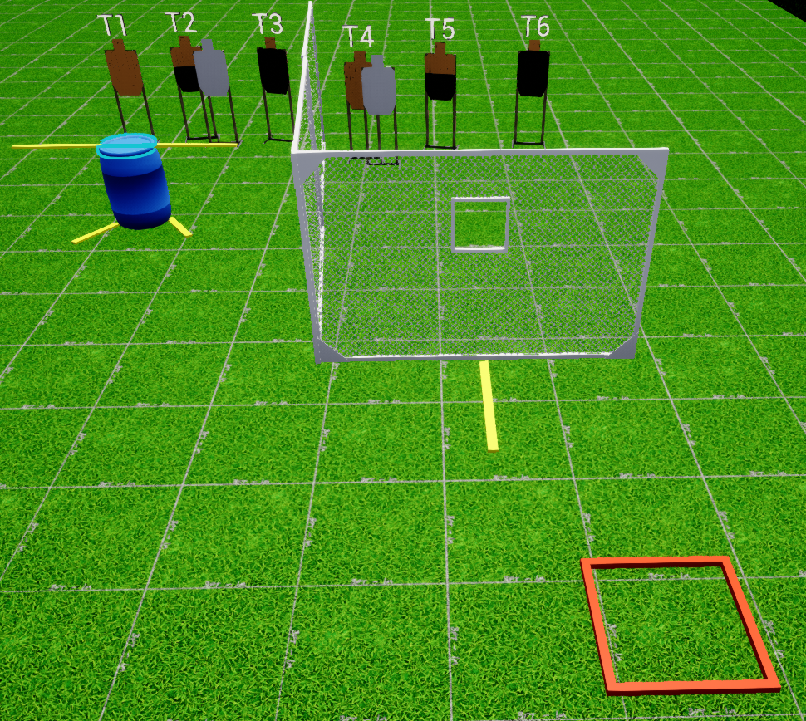
 | Interlake Sporting Association North Pistol, A Stage: Deja vu Course Designer: Vitaly Khozyainov
SCENARIO: You are on planet Mars, fighting your way to face the chief demon and return home to Earth (seethe game/movie ’Doom’ for more inspiration). Eliminate 2 groups consisting of an imp, a machine gunner and a Pain Elemental.
START POSITION: Standing in start box. Handgun: Loaded and holstered, facing uprange with wrists touching opposing shoulders. PCC: Loaded with safety on, stock touching belt muzzle pointed downrange |  | STRINGS: 1 ROUND COUNT: 6 START-STOP: Audible - Last shot Muzzle Safe Points: 180 degree rule
STAGE PROCEDURE: At the start signal, engage T4-T6 from P1 and T1-T3 from the low cover of P2.
Muzzle safe cone
PP1
T7
T8
T9
X
X
A

